Slide 1
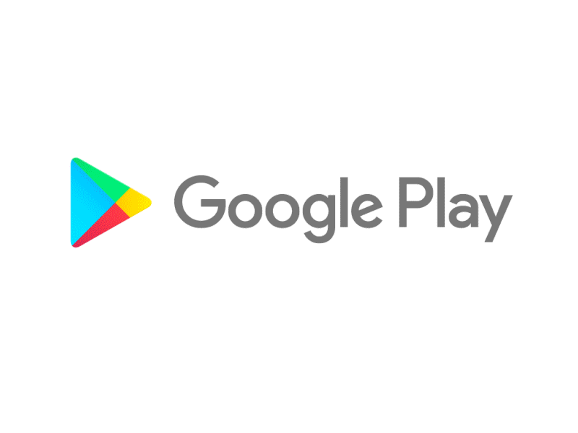
Capstone Project
Play Store App Review Analysis
By
Shreya Agrawal
Shubhangani Tiwari
Priyanshu Tiwari
Vaibhav lawate
Husain bharmal
Data Science Trainee, AlmaBetter

Slide 2




WHY ANALYZE THE GOOGLE PLAY STORE?
There are more than 3.04 million apps found on Google Play Store. The Play Store apps data has enormous potential to drive app-making businesses to success.

Slide 3
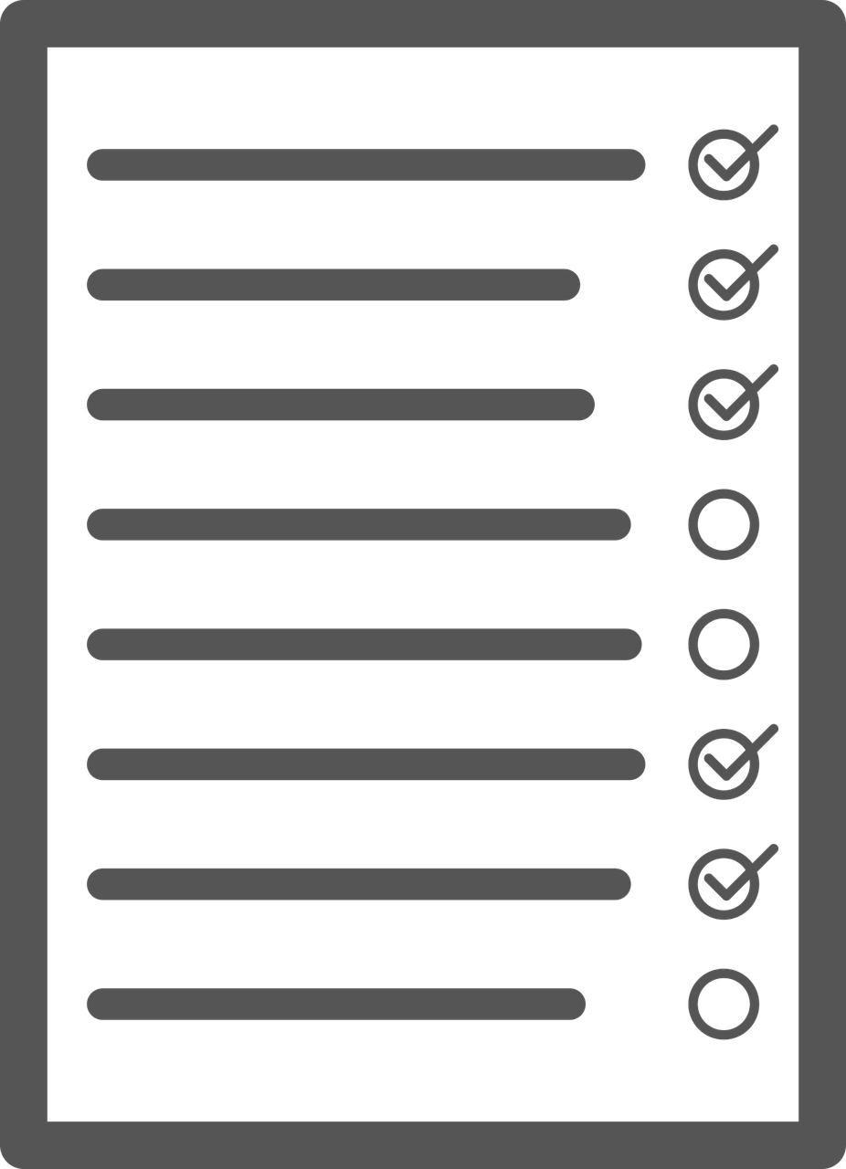
Agenda
Introduction
Problem statement
Dataset preparation
Attributes in play store data and user reviews data
App in each category
Category wise maximum no. of installs of app
Percentage of free and paid apps
Top Free Apps based on installs
Top Paid Apps based on Revenue generated
Percentage of reviews sentiment distribution
Most installed apps in communication category
Top expensive app
Android version based on each category
Feedback in popular category
Sentiment polarity relation with paid and free app
Is sentiment subjectivity proportional to sentiment polarity
App prices across the popular categories
Distribution of apps updated over the year and month
Correlation between Rating, Reviews, Size, Installs and Price
Distribution of Rating, Size and Sentiment Subjectivity of Apps
Challenges faced
conclusion

Slide 4

Introduction
The main goals of our project are-
To gather and analyze detailed information on apps in the Google Play Store in order to provide insights on app features and the current state of the Android app market.
To Explore and analyze the data to discover key factors responsible for app engagement and success.
To deliver insights to understand customer demands better and thus help developers to popularize the product. To clarify, the ‘popular’ in this project means a high number of installations.

Slide 5


Problem Statement
Problem Statement
Two datasets are provided, one with basic information and the other with user reviews for the respective app.
We must examine and evaluate the data in both datasets in order to identify the important characteristics that inﬂuence app engagement and success.
So, what factors inﬂuence an app's success?
An app is said to be successful if it has:
A high average user rating
A good number of positive reviews
A good number of installs

Slide 6

Dataset Preparation
Loading the datasets: Two datasets, First Play store app
dataset and User Reviews dataset.
Import Libraries: NumPy, Pandas, Seaborn and Matplotlib
Data cleaning: Null values, Finding and removing Outliers, Removing duplicate data.
Data Imputation: Filling the missing categorical values with mode and numerical values with median. Conversion of price, installs, reviews into numerical values.
Exploratory Data Analysis: Analyzing the data sets to summarize their main characteristics using statistical graphics and data visualizations method.

Slide 7
App- Name of the apps. Category- Category under which the app falls. Rating- Applications rating in Play Store. Reviews- Number of reviews given to apps. Size- Size of the apps. Installs- Number of installs of the apps. Type- App is free or paid. Price- Price of the apps. Content Rating - Appropriate target audience of the apps. Genres- Genres under which the app fall. Last updated- Date when the app last updated. Current Ver- Current version of the apps. Android Ver The Android operating system the app is compatible with. .
Attributes in Google Play store Data

Slide 8

Attributes in User reviews
App The name of the application.
Translated_Review Review text in English.
Sentiment Tells us about a view or opinion of the user with respect to the application, . which can be positive, neutral, or negative.
Sentiment_Polarity Sentiment in numerical form, ranging from -1.00 to 1.00.
Sentiment_Subjectivity Measure of the expression of opinions, evaluations, feelings, and speculations

Slide 9
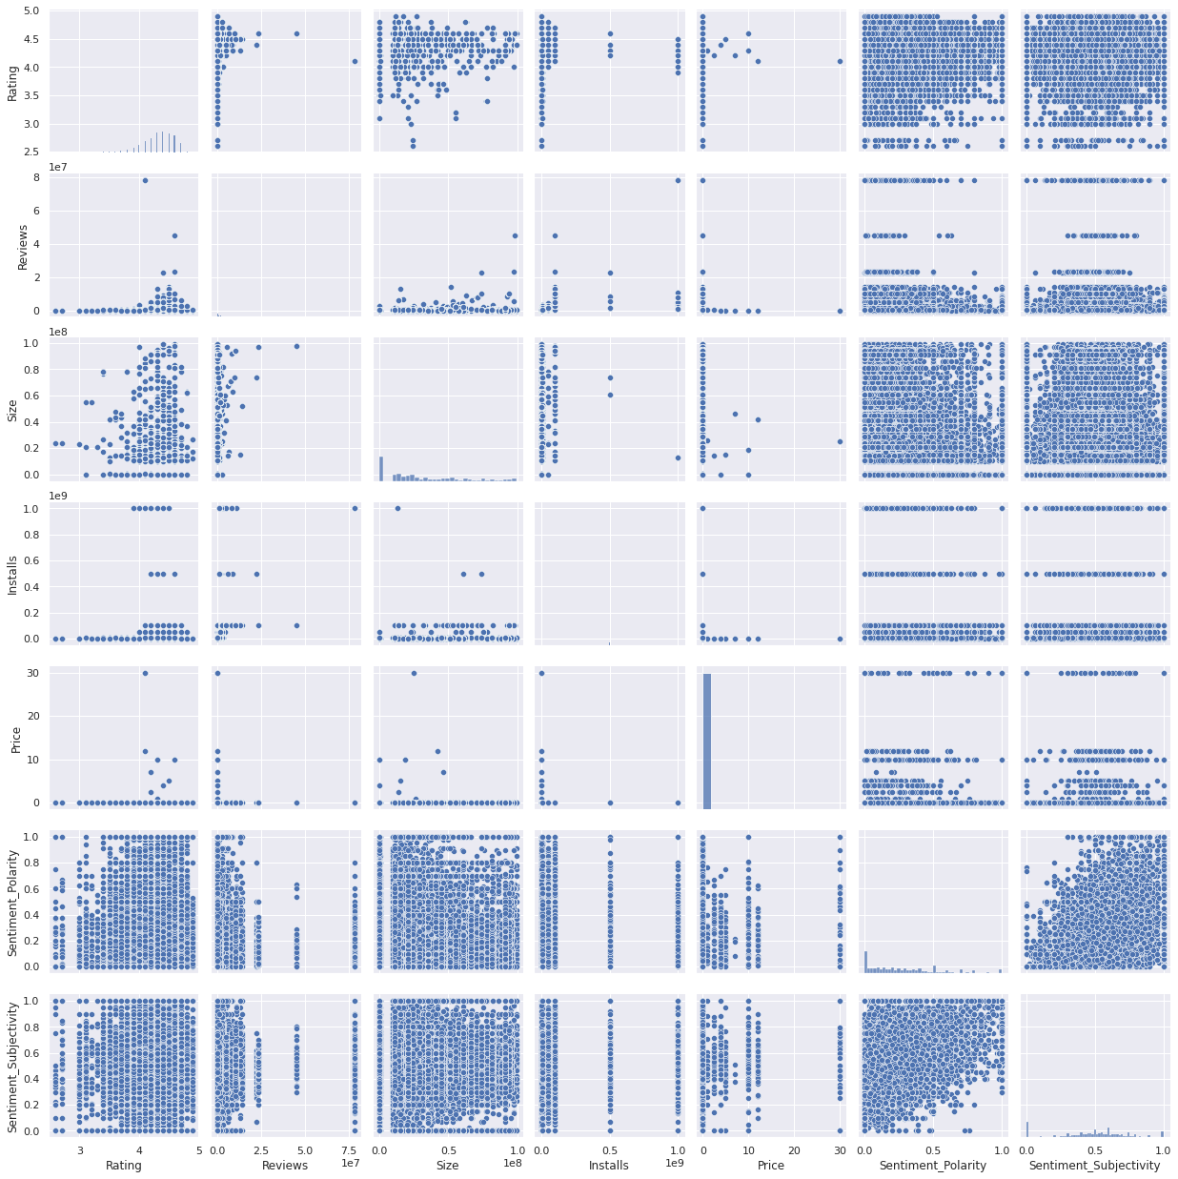
Pairwise Plot for all Numerical Variables:
Ratings.
Reviews.
Size.
Installs.
Price.
Sentiment Polarity.
Sentiment Subjectivity.

Slide 10
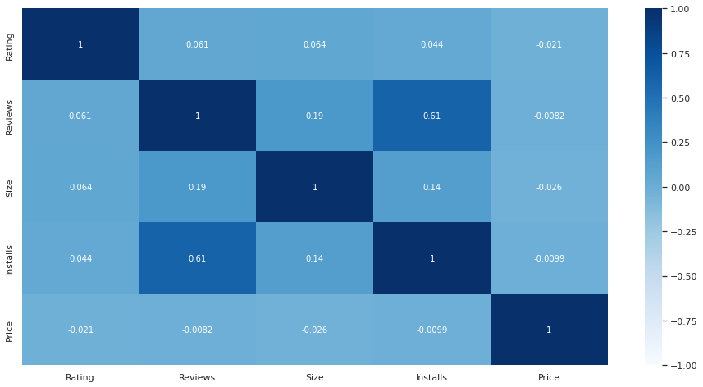
Correlation Heatmap
❏ There is a strong positive correlation between the Reviews and Installs.
❏ The Price is slightly
negatively correlated with
and
the Rating, Reviews, Installs.
❏ The Rating is slightly positively correlated with the Installs and Reviews.

Slide 11
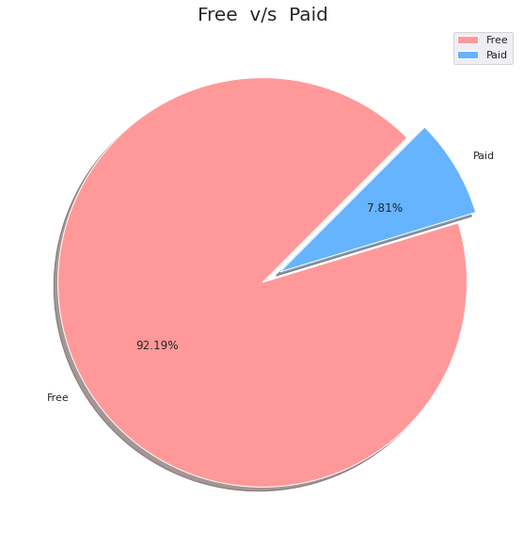

Percentage of Paid apps v/s Free apps
We Observed that 92.19% of Apps are free and only 7.81% of Apps are paid in Play store.

Slide 12
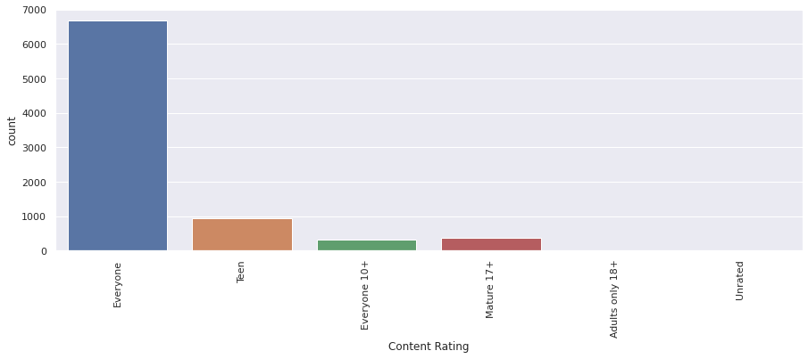
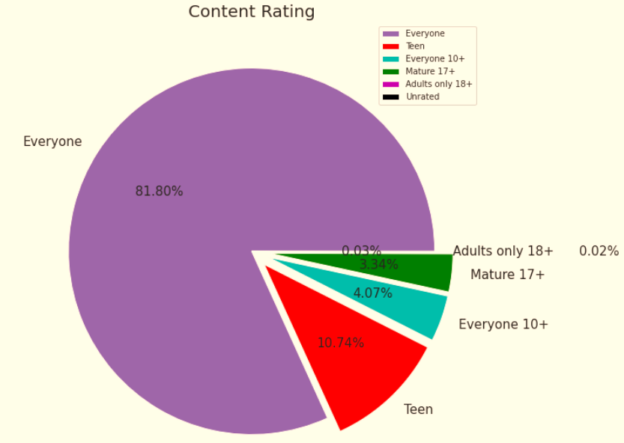
Content Rating
From the above plot, we can see that Everyone category having majority of apps count.
A majority of the apps (81.80%) in the play store are can be used by everyone. The remaining apps have various age restrictions to use it.

Slide 13
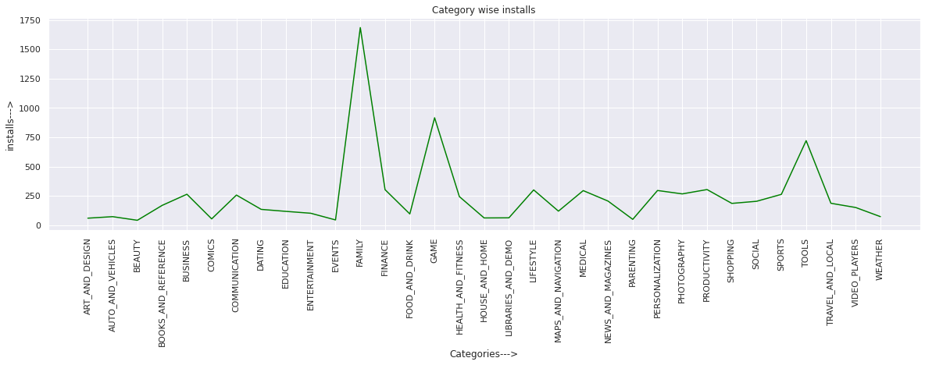
Categories of App have most number of installs
Categories with the most no. of installs are:
Category | No. of Installs
FAMILY | 1685
GAME | 916
TOOLS | 721
PRODUCTIVITY | 304
FINANCE | 303

Slide 14
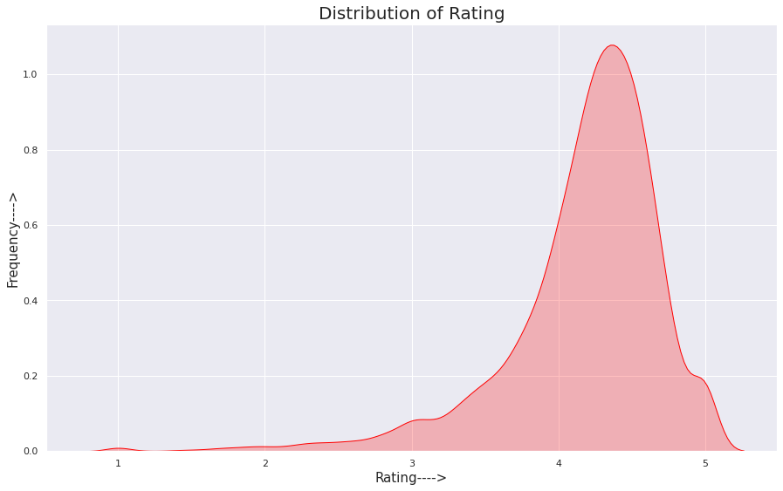
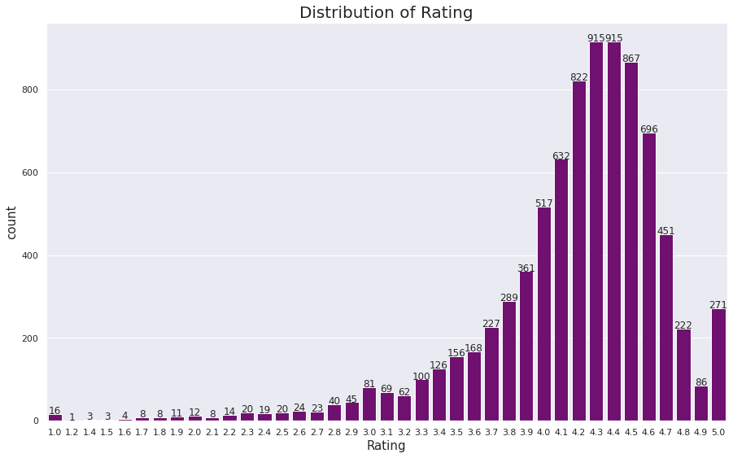
Distribution of Rating of Apps
The majority of the apps in the Play Store are top rated.
This implies that the majority of the users are happy with the services received via the respective app.

Slide 15
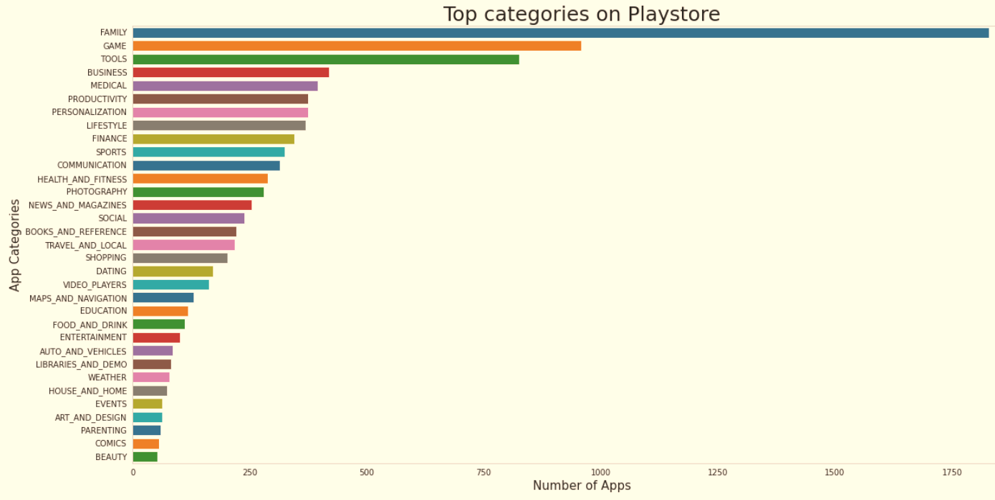
Count of Applications in each category
Family and Game apps have the
highest market prevalence. Surprising Tools, Business and Medical apps are also at the Top Count of applications.

Slide 16
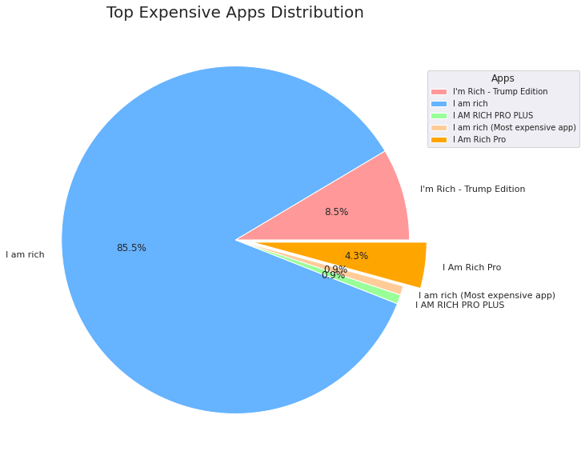
Top Expensive Apps
Findings:
From the above graph, we can interpret that “I am Rich“ app is the most expensive app in Play Store.

Slide 17
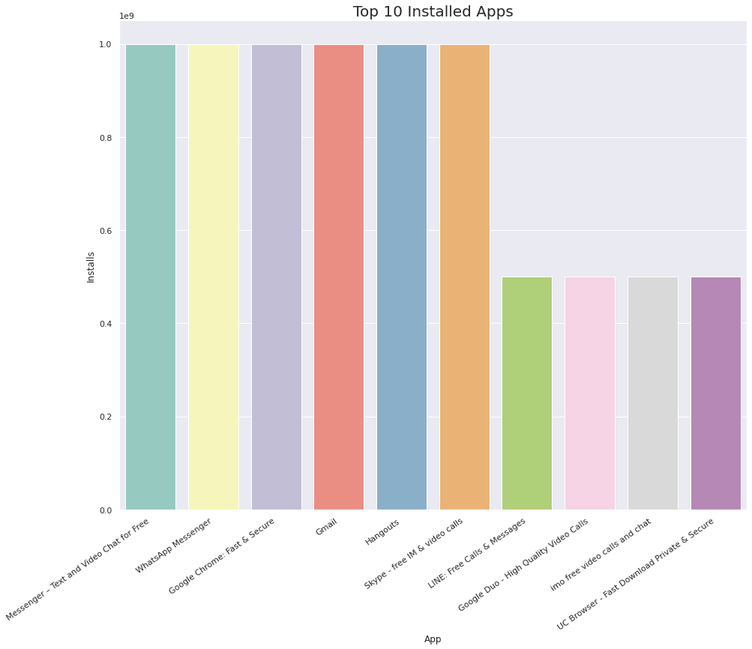
Top 10 installed apps in any category
findtop10incategory('Communication')
This graph shows the top installed apps in the ‘Communication’ category .
Messenger,
WhatsApp,
Google Chrome,
Gmail have the
highest installs.
In the same way, by passing different category names in the function findtop10incategory(str),we can get the top 10 installed apps for respective category.

Slide 18
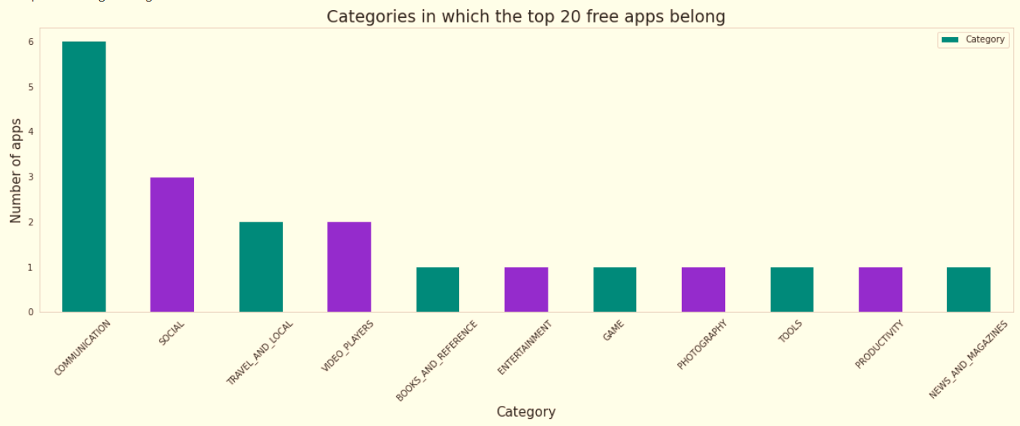
Top Free Apps
There are a total of 20 free apps with over one billion installs.
The top categories in which these apps fall are Communication(6), Social(3), Video Players(2), Travel and Local(2).

Slide 19
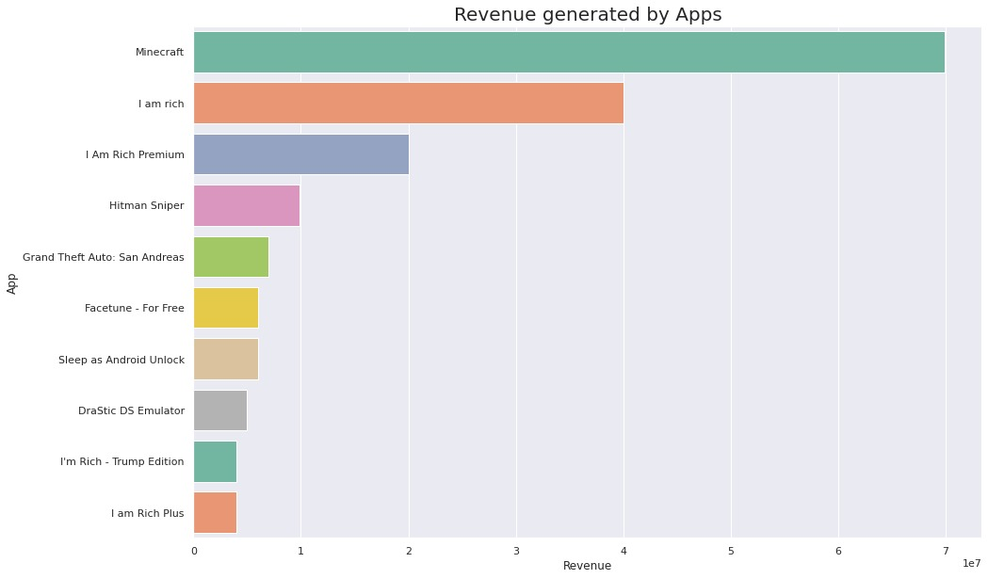
Top Paid Apps Based on Revenue Generated
Revenue generated is given by the formula:
Revenue = Installs * Price
Note that in this case, revenue refers to the money earned only from paid app installs.
The top categories in which these apps fall are Lifestyle(5), Family(5), and Game(4).
Minecraft, I am rich, and I am rich premium are the top paid apps based on revenue generated.

Slide 20
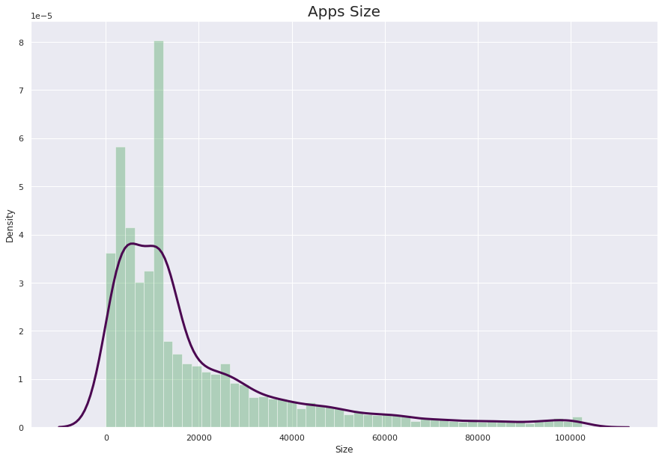

App Size Analysis
Summary:
This Distribution Plot shows that sizes of
most of the apps in PlayStore are between 0kb to 20000kb.

Slide 21
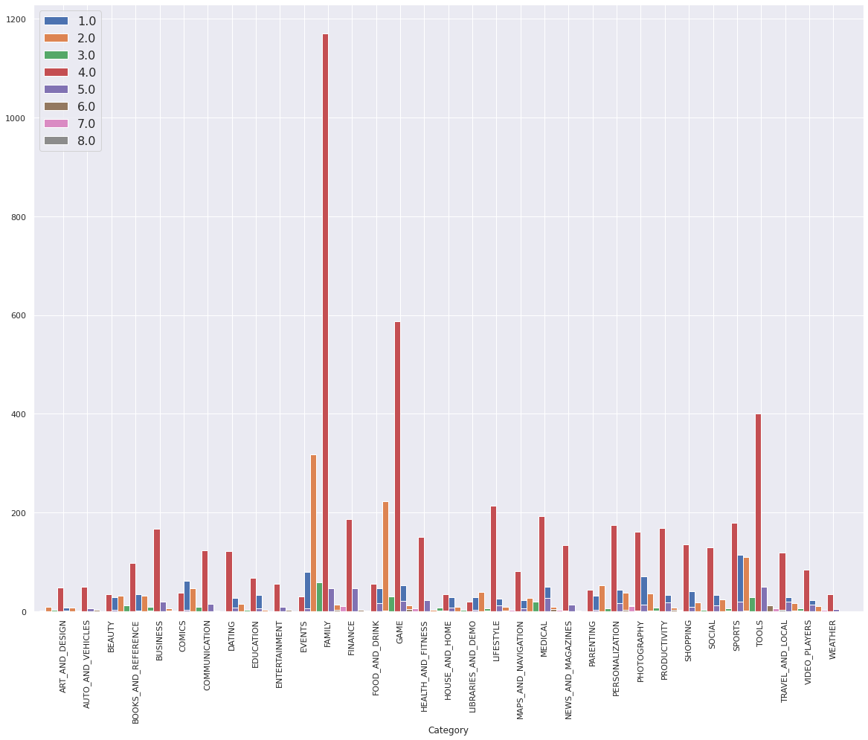
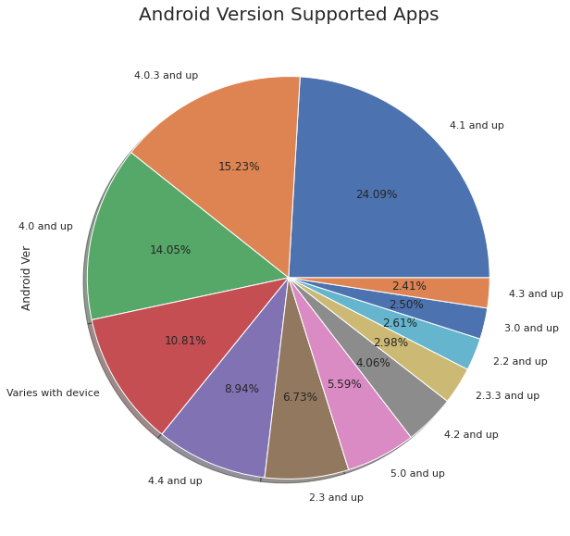
Android version based on each category
Android version 4.0 and above supported apps is very higher and more than 60% of total app support
.

Slide 22
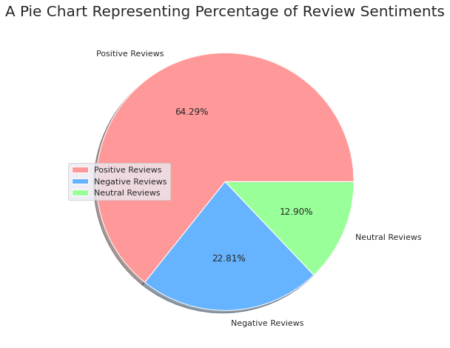
Percentage of Review Sentiments
The number of Unique Apps from Play store and User reviews merged dataset are 816.
From Sentiment column, 64% are Positive, 23% are Negative and 13% are Neutral values.

Slide 23
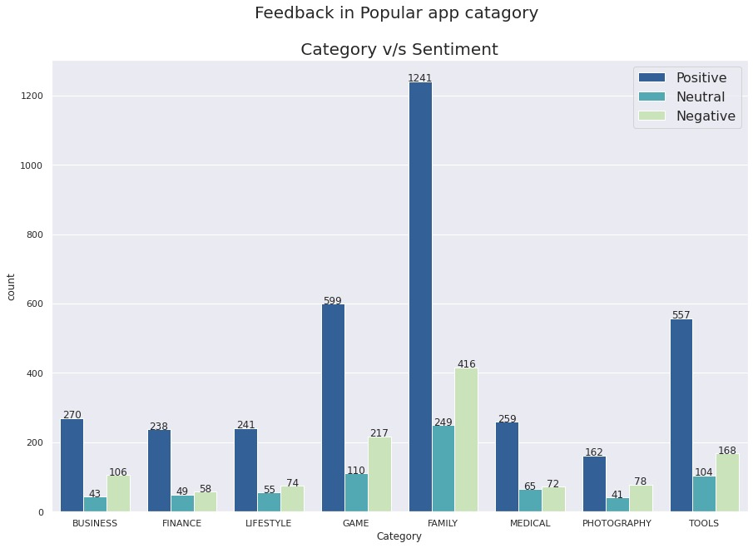
Feedback in Popular Category:
Visualisation is for Positive, Negative and Neutral sentiments for popular categories.
RESULT:
Chart shows that each category have the larger number of positive sentiments than negative and neutral sentiments.

Slide 24
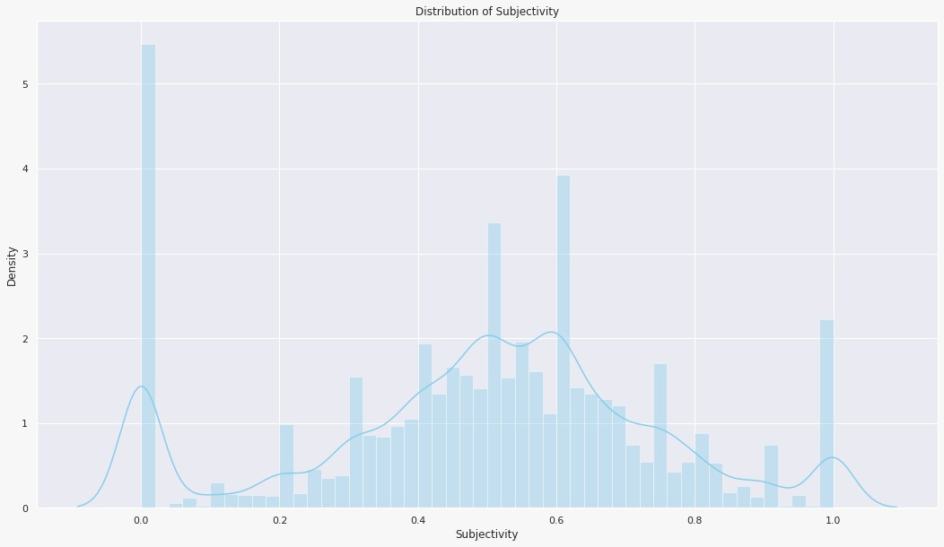
Distribution of Sentiment Subjectivity:
Findings:
0 - objective(fact)
1 - subjective(opinion)
It can be seen that maximum number of sentiment subjectivity lies between 0.4 to 0.7. From this we can conclude that maximum number of users give reviews to the applications, according to their experience.

Slide 25
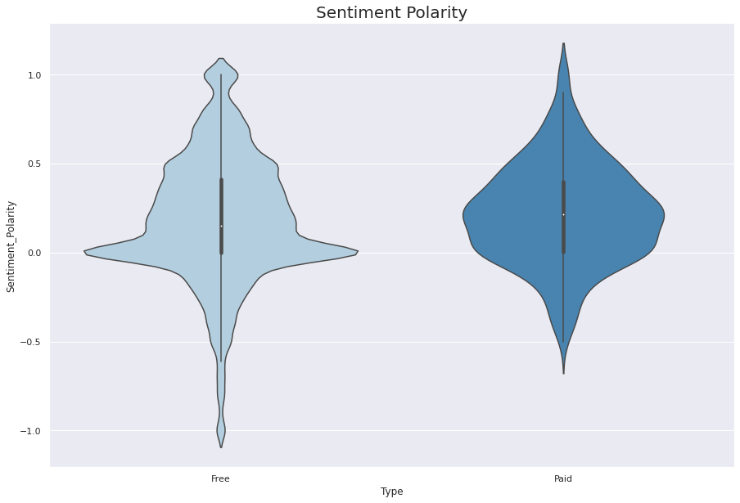
Sentiment Polarity relation with Paid and Free App:
This Violin Plot shows that density of Neutral sentiment polarity is high for both type of app.
Chances of Negative Sentiment Polarity is less for paid apps in comparison to Free apps.
⏩
⏪

Slide 26
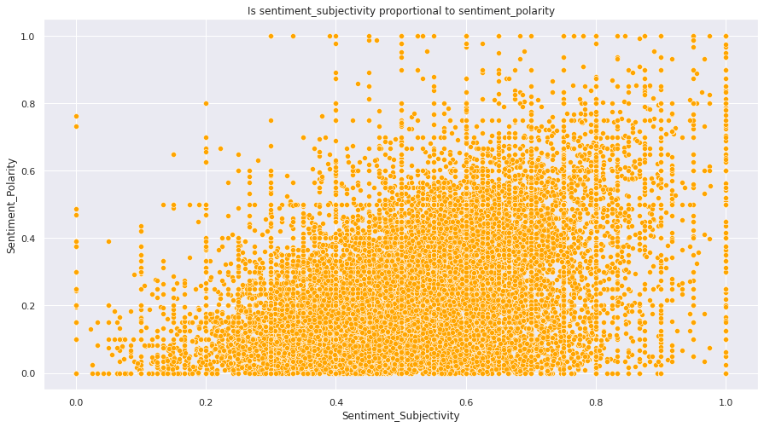
Is Sentiment_Subjectivity proportional to Sentiment_Polarity?
From the above scatter plot it can be concluded that sentiment subjectivity is not always proportional to sentiment polarity but in maximum number of case, shows a proportional behavior, when variance is too high or low.

Slide 27
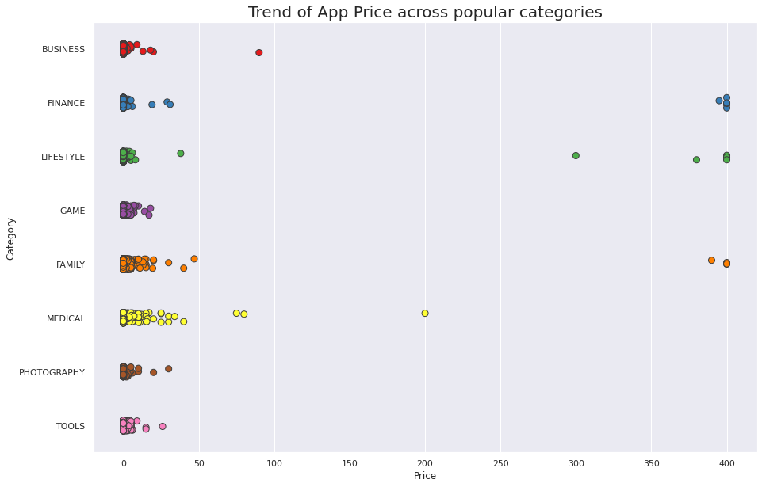
App Prices across the Popular Categories:
👇
Our insights from this plot:
From this strip plot between price and category, we infer that most of the apps on PlayStore are available for free and very few categories provide the apps of paid type and maximum price of any app is not exceeding the $400.

Slide 28
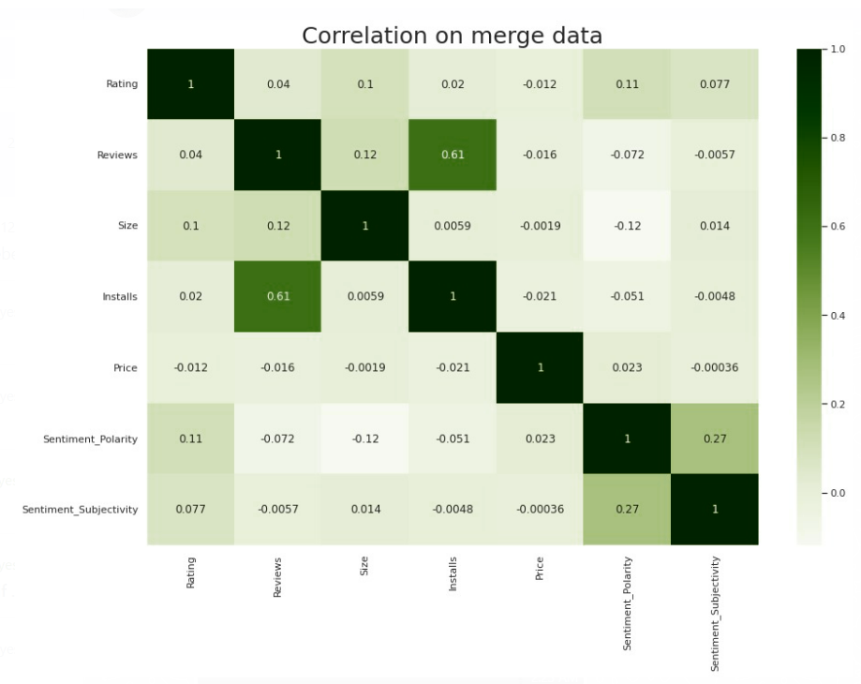
Co-Relation in merged data frame
In this correlation matrix, There is not significant relationship between Rating, Reviews, Size and Installs with respect to the Sentiment polarity and Sentiment subjectivity.

Slide 29
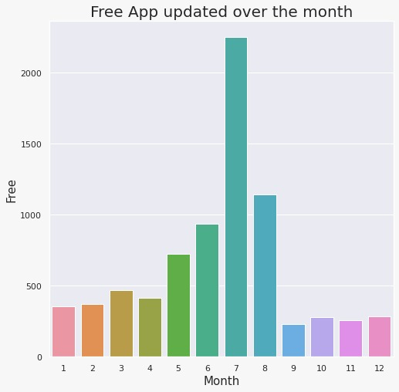
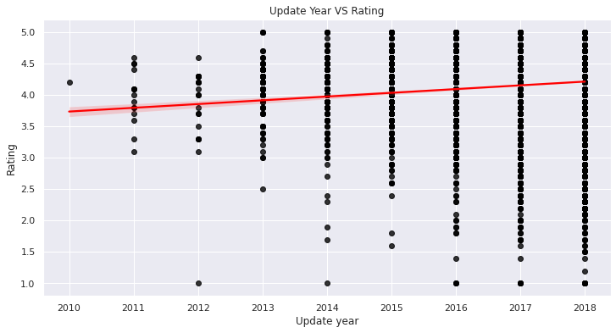
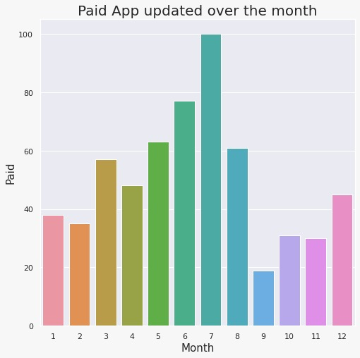
Distribution of Apps updated over the Year and Month
👆
Graph shows that the recently updated apps have more chances of getting high ratings…

Slide 30

Challenges Faced
Challenges Faced
Reading the dataset and comprehending the problem statement.
Examining the business KPIs for app development and devising a solution to the problem.
Handling the error, duplicate and NaN values in the dataset.
Designing multiple visualizations to summarize the information in the dataset and successfully communicate the results and trends to the reader.

Slide 31
Conclusion’s
92.19% apps are Free and 7.81% apps are paid in type.
81.80% apps have Everyone content rating.
Events category has a highest mean rating of 4.39 and Dating category has lowest 4.05 rating.
Family, Game and Tools are top three categories having 1906, 926 and 829 app count.
Most competitive category: Family
Category with the highest number of installs: Game
Tools, Entertainment, Education, Business and Medical are top Genres.
8784 Apps are having size less than or equal to 50 MB.
7749 Apps has rating more than or equal to 4.0 including both type of app.
Overall sentiment count of merged dataset in which Positive sentiment count is 64.04%, Negative 21.29% and Neutral 14.67%.

Slide 32
Conclusion’s
It's good to develop a Free type app and having a content rating for Everyone.
Percentage of apps that are top rated = 81.80%
There are 20 free apps that have been installed over a billion times
Minecraft is the only app in the paid category with over 10M installs, and also has produced the most revenue only from installation fee.
Price, Rating, Size has no or very less correlation with Sentiment Polarity.
The median size of the apps in the play store is 12 MB
The apps whose size varies with device has the highest number average app installs.
The apps whose size is greater than 90 MB has the highest number of average user reviews, ie, they are more popular than the rest.
Helix Jump has the highest number of positive reviews and Angry Birds Classic has the highest number of negative reviews.

Slide 33


